Slide 1



Group - 9
DYNAMIC LOAD BALANCING WITH HORIZONTAL SCALING
Implementation with Codes
(Cloud Computing)

Slide 2



Problem Statement
As web applications experience varying levels of traffic, ensuring smooth performance and minimizing server downtime and balancing load becomes crucial.
In highly distributed systems, managing server load efficiently is a key challenge. When multiple servers handle user requests, some servers may become overloaded, while others may remain underutilized, managed by horizontal scaling.
This leads to performance degradation, increased response times, and higher operational costs. Additionally, the failure of any individual server can cause service disruption unless proper fault tolerance is implemented.

Slide 3

Group - 9
Objectives
What we wish to achieve?
Efficient Traffic Distribution: Implement a dynamic load balancing system to distribute traffic across multiple servers, ensuring optimal performance.
Horizontal Scaling: Automatically scale server resources by adding or removing servers based on CPU usage to enhance resource utilization and system performance.
[Cont...]

Slide 4


Group - 9
Algorithm Integration: Support multiple load balancing algorithms, including Round Robin, Least Connections, Least Response Time and Least resource utilization allowing for dynamic switching based on traffic patterns.
Continuous Monitoring: Continuously monitor server health to ensure high availability, redirecting traffic to healthy servers in case of failures.
High Availability and Fault Tolerance: Maintain system uptime and resilience through proactive traffic management and server monitoring.

Slide 5
Group - 9
Load Balancer
What is a Load Balancer?
Load Balancer is a networking device or software application.
Distributes incoming network traffic.
Ensures high availability and reliability.
Optimizes resource use and performance.
Protects against server overloads.
Can be hardware or software-based.

Slide 6
Group - 9
Load Balancing Algorithms
What are LB Algorithms?
LB algorithms define how incoming requests are distributed across multiple servers..
The goal is to choose the best server for each client request.
Purpose:
Ensure efficient distribution of traffic to prevent overloading servers and improve overall system performance.
Categories of LB Algorithms
Static Algorithms:
Dynamic Algorithms:
Fixed rules, independent of server state.
eg: Random, Round Robin, IP hash etc.,
Adapt based on current server conditions
e.g., response time, active connections etc.,

Slide 7


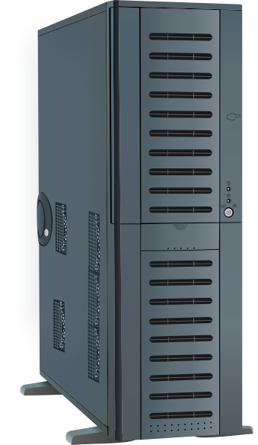


Architecture
Round Robin
Least Connections
Response Time
CPU Utilization
s-1
If both lb’s are healthy / 2nd one is down
Choose
Algorithm
lb-1
s-2
Checks server health
req
s-3
Check if load balancers are healthy
req
Round Robin
Least Connections
Response Time
CPU Utilization
s-4
Checks server health
Front-end js script
req
s-5
Choose
Algorithm
If lb-1 is down & lb-2 is healthy
Users
(interacting with any application)
s-6
lb-2
s-7
Load balancers(2)
Algorithms
s-1 to s5 are primary servers
S-6, 7 are scalable servers
Servers

Slide 8
Group - 9
ALGORITHMS
Implementation of algorithms
We used several algorithms in this such as:
Round Robin
Least Connections
Least Response time
Least resource Utilization

Slide 9
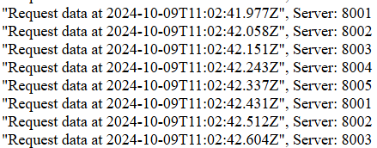
Group - 9
Round Robin
Implementation of algorithms
Distributes requests sequentially to each server in a circular order, ensuring an even load across all servers.
Output:

Slide 10
Group - 9
Round Robin
Pros and Cons?
Pros
Cons
Simple to implement.
Distributes requests evenly.
No server state tracking is required.
Doesn't consider server load.
May overload slower servers.
May result in request latency if some servers are slower.

Slide 11
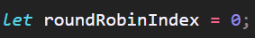
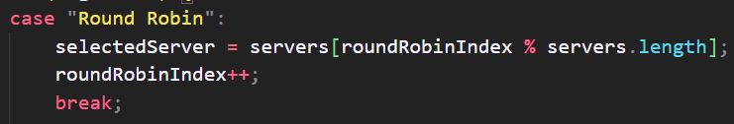
Group - 9
Round Robin
We have an array `servers` containing healthy servers.
The selected server is chosen by index % len(servers) to avoid arrayOutOfBound error.
We will select the server in a circular loop and then increment the index to server next request.

Slide 12
Group - 9
Least Connections:
Implementation of algorithms
Directs traffic to the server with the fewest active connections, optimizing resource utilization and enhancing response times.

Slide 13
Group - 9
Least Connections:
Pros and Cons?
Pros
Cons
Directly accounts for active connections.
Better for servers with varying capacities.
Helps prevent server overload by considering active connections.
Requires tracking connection counts.
Overhead for managing connections.
Doesn't account for the processing time of ongoing requests.

Slide 14
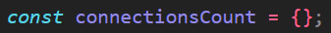
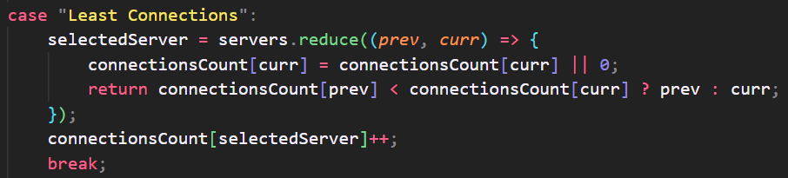
Group - 9
Least Connections:
We track active connections for each server in the `connectionsCount` object, using the server's URL as the key. The server with the fewest active connections is selected for the next request.
After a server is selected, its connection count is incremented and then decremented when req leaves.

Slide 15
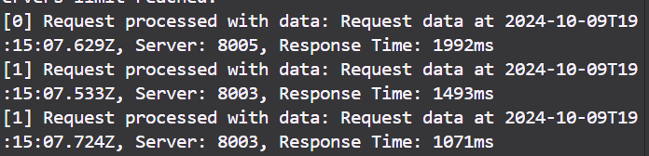
Group - 9
Least Response Time
Implementation of algorithms
Routes requests to the server that has the lowest response time, improving overall performance and user experience.
Output:

Slide 16
Group - 9
Least Response Time
Pros and Cons?
Pros
Cons
Improves user experience by minimizing latency.
Adapts well to varying server performance.
Efficiently utilizes faster servers.
Requires continuous monitoring of response times, adding overhead.
Its performance is dependent on how good the response time estimates are.

Slide 17
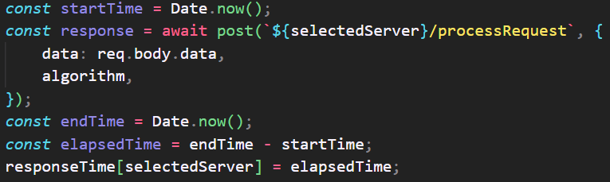
Group - 9
Least Response Time
Response time calculated as ` response recieve time - request start time`
Uses a `responseTime` object to store each server's response time.
Uses `reduce` to find the server with the lowest response time.
Sends the request to the selected server.
Records the processing time in `responseTime` for future comparisons.

Slide 18
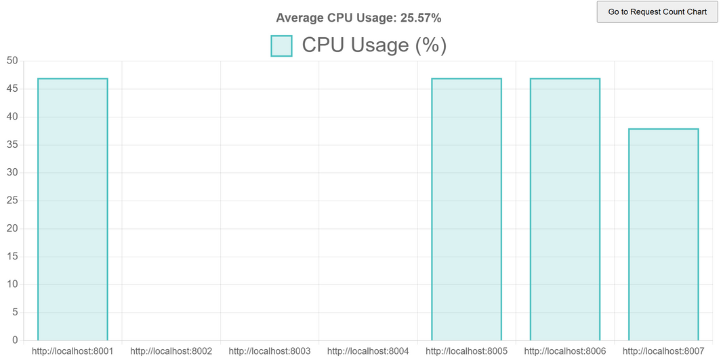
Group - 9
Least resource Utilization
Implementation of algorithms
Use metrics like CPU usage, connections count, response time to calculate server score and select the most suitable server based on current workload conditions.
Output:

Slide 19
Group - 9
Least resource Utilization
Pros and Cons?
Pros
Cons
Balances load based on server performance.
Efficient resource usage.
Adapts to changes in server workload in real time.
Requires real-time CPU monitoring
More complex to implement and manage.
May favor servers that are slower but have lower CPU utilization at the moment.

Slide 20
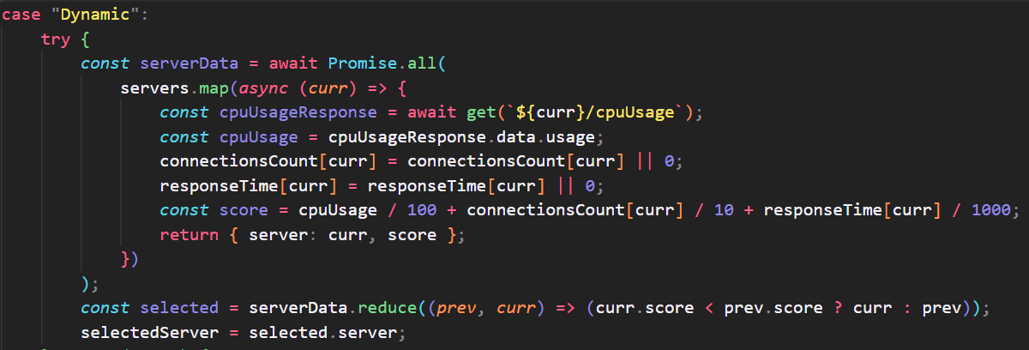
Group - 9
Code:

Slide 21
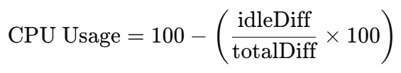
Group - 9
CPU Utilization calculation
Calculates CPU utilization percentage.
Retrieves CPU stats using _cpus().
Tracks totalDiff (total CPU time) and idleDiff (idle time).
Compares current and previous CPU times.
Returns: CPU utilization percentage (0% = idle, 100% = fully utilized).

Slide 22
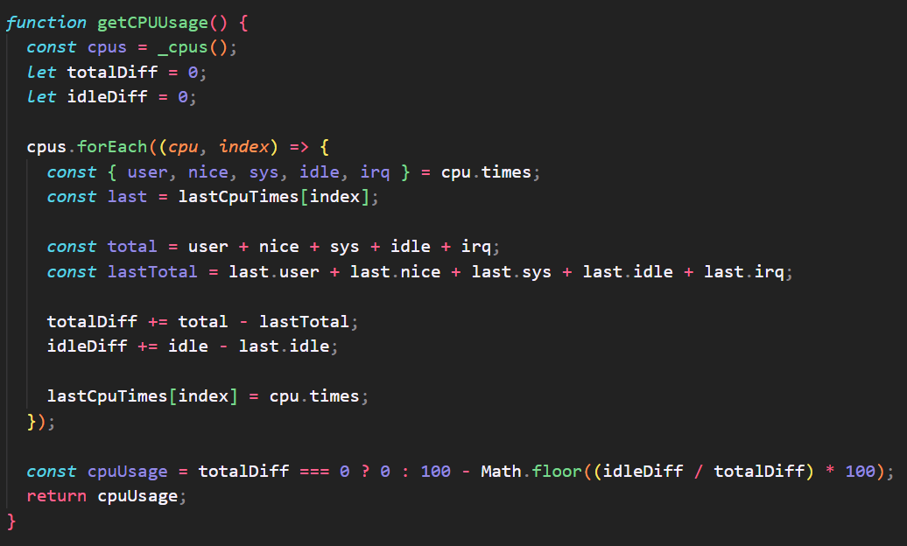
Group - 9
CPU Utilization Code:

Slide 23
Group - 9
Routes
Load Balancer
Application Server
GET /health
POST /sendRequest
GET /metrics
GET /health
GET /cpuUsage
POST /processRequest
GET /requestsPerSecond
GET /activeConnections

Slide 24
Group - 9
Fault Tolerance
Health Checks: Monitor server status regularly.
Graceful Degradation: Maintain partial functionality during failures.
Fallback Mechanism: Reroute to healthy servers if needed.
Error Handling: Provide clear error responses.
Logging: Track errors for quick fixes.
Dynamic Scaling: Adjust server count based on load.

Slide 25


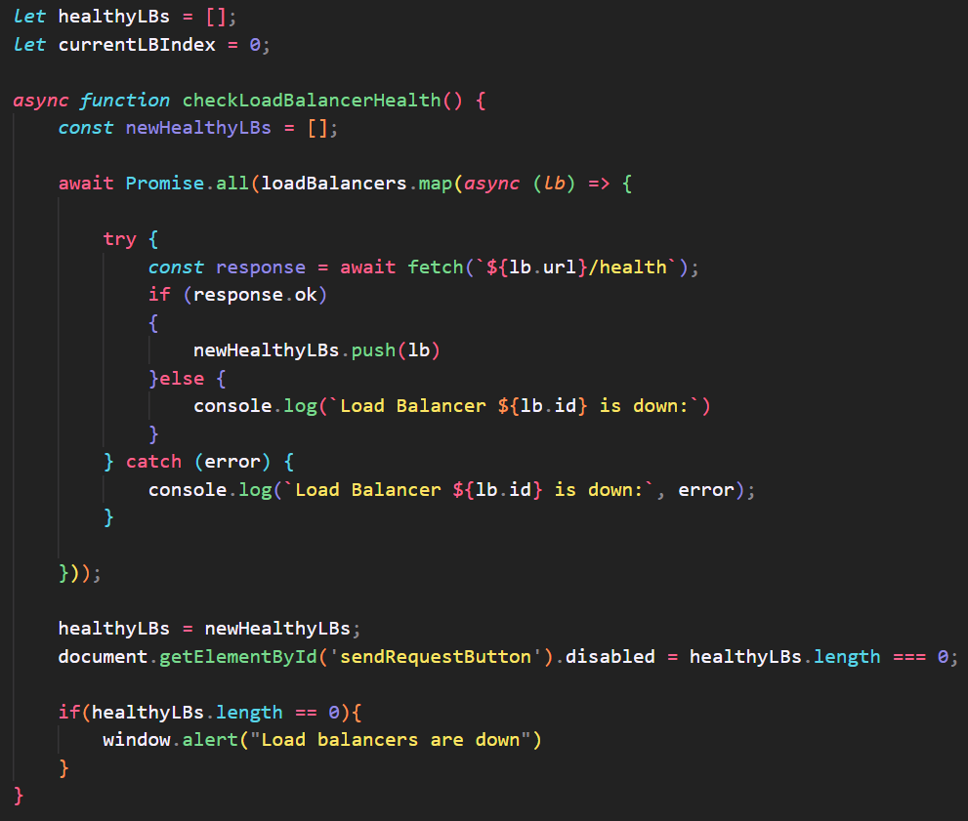
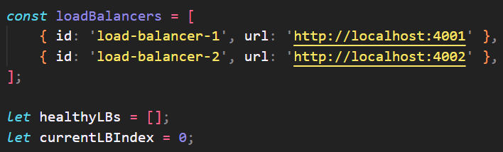
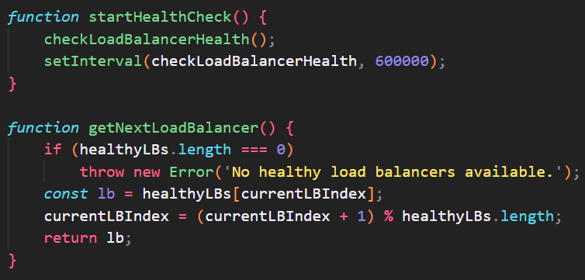
Group - 9
Load balancer Health check

Slide 26
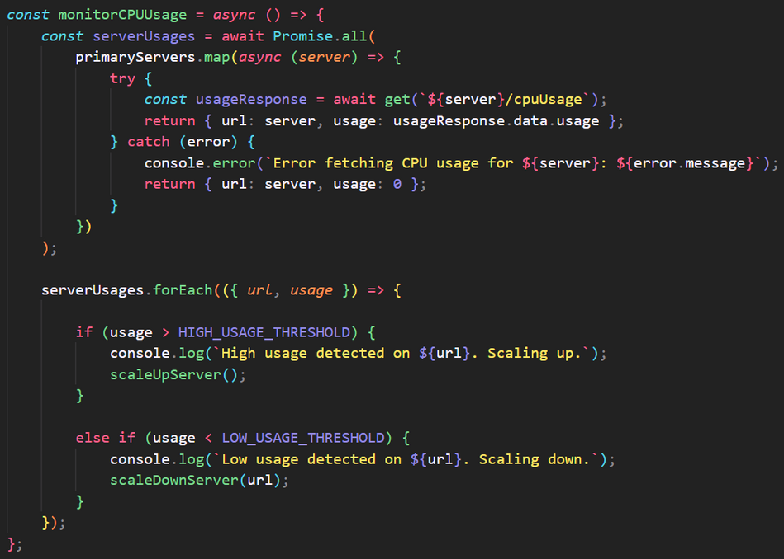
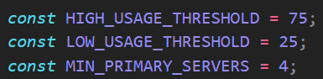
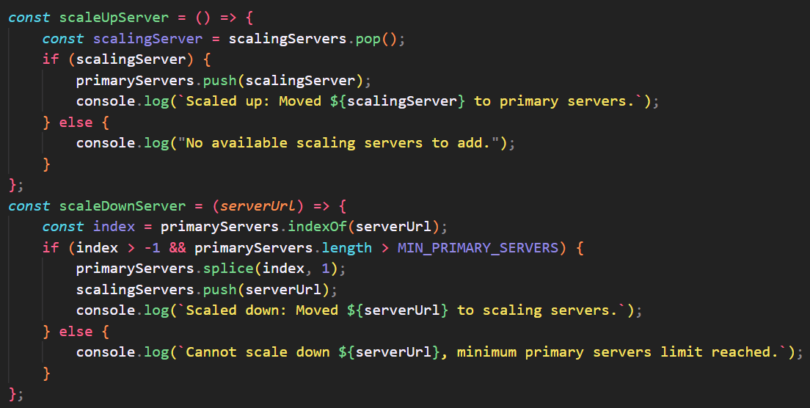
Group - 9
Horizontal Scaling
Threshold values:

Slide 27

Group - 9
Thank You...

